Slide 1
SALES AND PROFIT ANALYSIS OF COMPUTER HARDWARES AND PERIPHERALS
PREPARED BY:
BHUVAN SG

Slide 2
INTRODUCTION
Hardware are physical parts that make your computer.
Peripherals are pieces of hardware that added on computer for it to work more efficiently.
The company has different stores across India and has 3 zones (north, south, central).
The sales are dynamically increasing all over the places across India.

Slide 3
contents
Problem overview
Model comparison
Preventive measures
Recommendation
Potential benefits

Slide 4
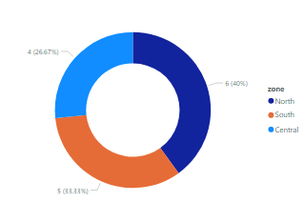
Problem overview
In dynamic growing market, its found difficult in tracking sales.
Accurate insights of sales are not gained in north, south and central regions.
Sales are declining in growing market.
Customer with big order are decreasing.
Return of investment in certain regions are less even with more sales.

Slide 5
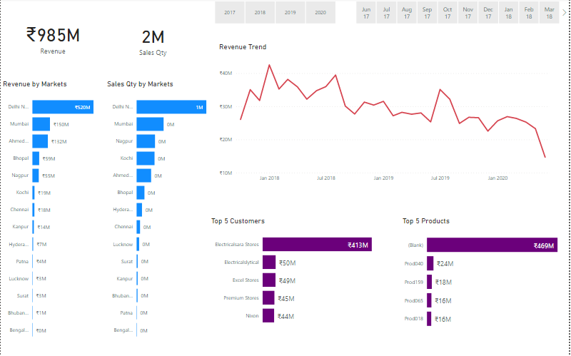
Model comparison
Delhi has generated about 50% of total revenue and sales quantity.
Revenue trend has decreased continuously over years.
In year 2018 highest revenue is generated and low in 2020.

Slide 6
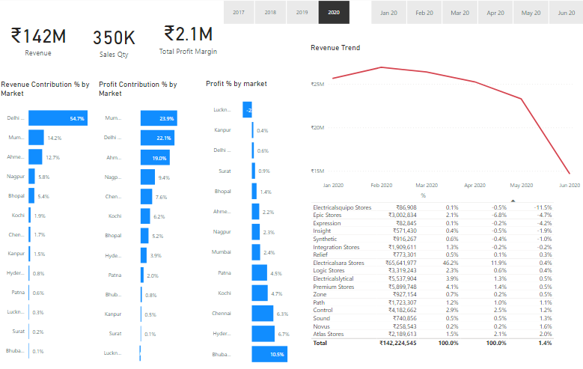
Model comparison
Mumbai has contributed more profit percentage when compared to other places.
Lucknow has negative profit by markets.
In June 2020 the revenue has declined to less than 10M.

Slide 7
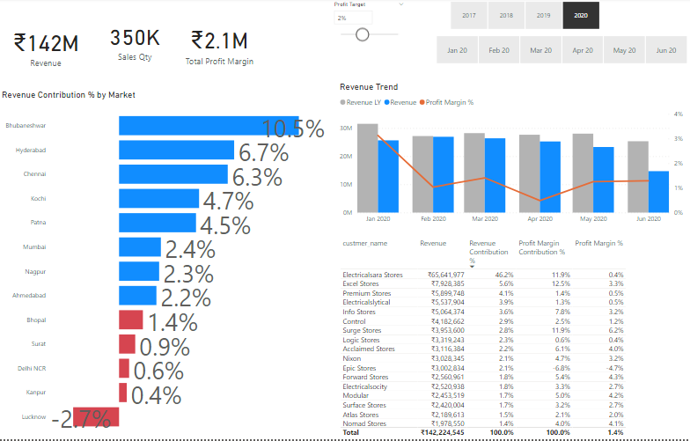
Model comparison
Electric Sara stores has 50% of total revenue but profit margin is low.
Excel stores contributes 5.6% but profit margin is 3.3%.
Trend shows Bhopal, Surat, Delhi, Kanpur and Lucknow has low revenue contribution percentage by market.

Slide 8
Preventive measures
01
Duplicate the
strategy used in
profit areas
to non profit areas.
02
Product quality
Attraction(packing)
Advertisement
Discounts
03
Communicating to the big order customers and finding reasons for low order.
04
Identifying top 5 low customers, negative profit margin customers and guide for higher ROI.
05
Creating contracts/targets with low margin customers for more sales.

Slide 9
recommendation
Healthy communication between management and suppliers.
Identifying which area the particular product will be sold.
Giving more discounts to market place were there is more return of investment.
Terminating the store were there is negative profit margin and revenue.

Slide 10
Potential benefits:
Increased profit margins.
More production of products.
Distribution of products all over the India.
Healthy relationship with customers.

